Slide 1
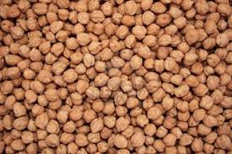
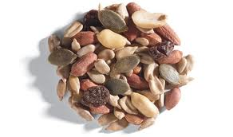
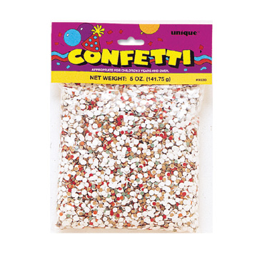
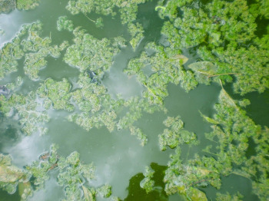
Beans
Seeds
The beans, like seeds, are different sizes.
Are some marbles easier to pick up than others?
Confetti
Algae
Have you ever seen ponds that look green in the summer? That is green algae floating on the surface. Some birds have beaks that can scoop up this floating food source.

Slide 2
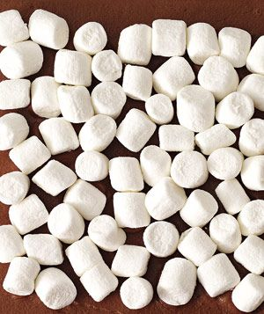
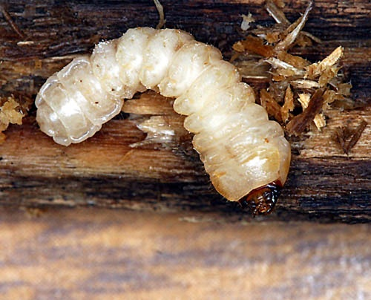
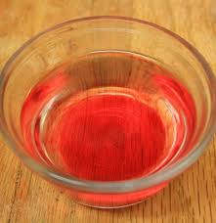
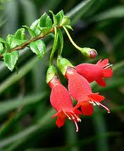
Marshmallows
Insect Larvae
Some insects lay their eggs in trees. The eggs hatch into larvae which then develop into adults. Birds that can bore into the wood can eat these insects.
Colored Water
Flower Nectar
Nectar is a sugary liquid produced by plants to attract pollinators. Some birds have special beaks and tongues that help them ‘drink’ the nectar from flowers.

Slide 3
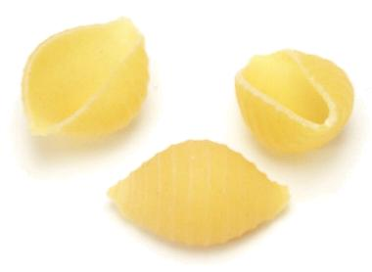
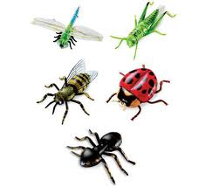
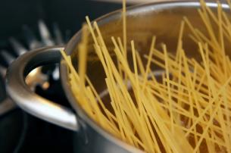
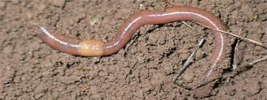
Dry Pasta
Insects
& Worms
Worms live in the dirt, and many insects crawl around on the ground under plants. What type of beak would a bird need to catch both insects AND worms?

